Slide 1

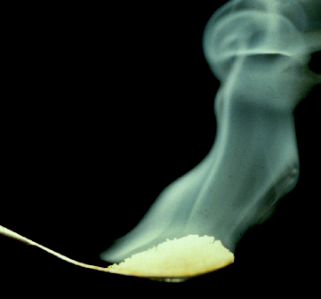
CHAPTER 10
Reactions in Aqueous Solutions I: Acids, Bases & Salts

Slide 2
CHAPTER GOALS
Properties of Aqueous Solutions of Acids and Bases
The Arrhenius Theory
The Hydronium Ion (Hydrated Hydrogen Ion)
The BrØnsted-Lowry Theory
The Autoionization of Water
Amphoterism
Strengths of Acids

Slide 3
CHAPTER GOALS
Acid-Base Reactions in Aqueous Solutions
Acidic Salts and Basic Salts
The Lewis Theory
The Preparation of Acids

Slide 4
Properties of Aqueous Solutions of Acids and Bases
Aqueous acidic solutions have the following properties:
They have a sour taste.
They change the colors of many indicators.
  Acids turn blue litmus to red.
  Acids turn bromothymol blue from blue to yellow.
They react with metals to generate hydrogen, H_{2(g)}.

Slide 5
Properties of Aqueous Solutions of Acids and Bases
They react with metal oxides and hydroxides to form salts and water.
They react with salts of weaker acids to form the weaker acid and the salt of the stronger acid.
Acidic aqueous solutions conduct electricity.

Slide 6
Properties of Aqueous Solutions of Acids and Bases
Aqueous basic solutions have the following properties:
They have a bitter taste.
They have a slippery feeling.
They change the colors of many indicators
  Bases turn red litmus to blue.
  Bases turn bromothymol blue from yellow to blue.
They react with acids to form salts and water.
Aqueous basic solutions conduct electricity.

Slide 7
The Arrhenius Theory
Svante Augustus Arrhenius first presented this theory of acids and bases in 1884.
Acids are substances that contain hydrogen and produces H⁺ in aqueous solutions.
Two examples of substances that behave as Arrhenius acids:

Slide 8
The Arrhenius Theory
Bases are substances that contain the hydroxyl, OH, group and produce hydroxide ions, OH⁻, in aqueous solutions.
Two examples of substances that behave as Arrhenius bases:

Slide 9
The Arrhenius Theory
Neutralization reactions are the combination of H⁺ (or H₃O⁺) with OH⁻ to form H₂O.
Strong acids are acidic substances that ionize 100% in water.
  List of aqueous strong acids:
  HCl, HBr, HI, H₂SO₄, HNO₃, HClO₄, HClO₃
Strong bases are basic substances that ionize 100% in water.
  List of aqueous strong bases:
  LiOH, NaOH, KOH, RbOH, CsOH,
  Ca(OH)₂, Sr(OH)₂, Ba(OH)₂

Slide 10
The Arrhenius Theory
For a typical strong acid-strong base reaction, the formula unit, total ionic, and net ionic equations are given below.
The formula unit equation is:
The total ionic equation is:
You do it!

Slide 11
The Arrhenius Theory
What are the spectator ions in this reaction?
You do it!
The net ionic equation is:
You do it!
All strong acid-strong base reactions have this net ionic equation.

Slide 12
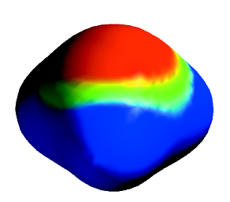
The Hydronium Ion
(Hydrated Hydrogen Ion)
The protons that are generated in acid-base reactions are not present in solution by themselves.
Protons are surrounded by several water molecules.
  How many varies from solution to solution.
H⁺_{(aq)} is really H(H₂O)_{n}⁺
  Where n is a small integer.
Chemists normally write the hydrated hydrogen ion as H₃O⁺ and call it the hydronium ion.

Slide 13
The BrØnsted-Lowry Theory
J.N. BrØnsted and T.M. Lowry developed this more general acid-base theory in 1923.
An acid is a proton donor (H⁺).
A base is a proton acceptor.
Two examples to illustrate this concept.

Slide 14
The BrØnsted-Lowry Theory
Acid-base reactions are the transfer of a proton from an acid to a base.
Note that coordinate covalent bonds are often made in these acid-base reactions.

Slide 15
The BrØnsted-Lowry Theory
An important part of BrØnsted-Lowry acid-base theory is the idea of conjugate acid-base pairs.
  Two species that differ by a proton are called acid-base conjugate pairs.
For example we can use this reaction:
HNO₃ + H₂O → H₃O⁺ + NO₃⁻
Identify the reactant acid and base.
  You do it!
Find the species that differs from the acid by a proton, that is the conjugate base.
You do it!

Slide 16
The BrØnsted-Lowry Theory
Find the species that differs from the base by a proton, that is the conjugate acid.
You do it!
HNO₃ is the acid, conjugate base is NO₃⁻
H₂O is the base, conjugate acid is H₃O⁺

Slide 17
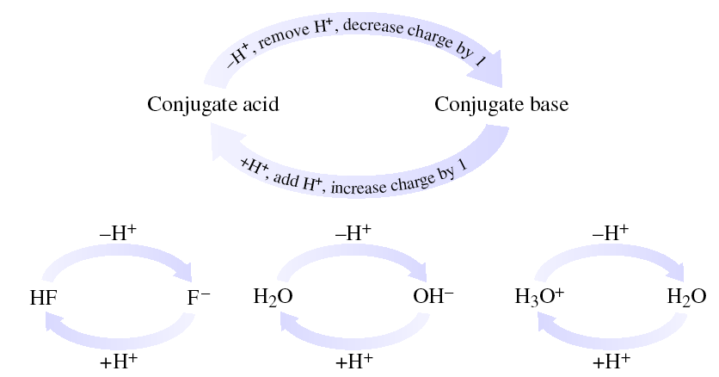
The BrØnsted-Lowry Theory
Conjugate acid-base pairs are species that differ by a proton.
  Some examples:

Slide 18
The BrØnsted-Lowry Theory
Standard format for writing conjugate acid-base pairs.

Slide 19
The BrØnsted-Lowry Theory
The major differences between Arrhenius and Brønsted-Lowry theories.
The reaction does not have to occur in an aqueous solution.
Bases are not required to be hydroxides.

Slide 20
The BrØnsted-Lowry Theory
An important concept in BrØnsted-Lowry theory involves the relative strengths of acid-base pairs.
Weak acids have strong conjugate bases.
Weak bases have strong conjugate acids.
The weaker the acid or base, the stronger the conjugate partner.
The reason why a weak acid is weak is because the conjugate base is so strong it reforms the original acid.
Similarly for weak bases.

Slide 21
The BrØnsted-Lowry Theory
Since NH₃ is a weak base, NH₄⁺ must be a strong acid.
  NH₄⁺ gives up H⁺ to reform NH₃.
Compare that to
NaOH → Na⁺ _{(aq)} + OH⁻_{(aq)}
  Na⁺ must be a weak acid or it would recombine to form NaOH
Remember NaOH ionizes 100%.
  NaOH is a strong base.

Slide 22
The BrØnsted-Lowry Theory
Amines are weak bases that behave similarly to ammonia.
The functional group for amines is an -NH₂ group attached to other organic groups.

Slide 23
The Autoionization of Water
Water can be either an acid or base in Bronsted-Lowry theory.
Consequently, water can react with itself.
  This reaction is called autoionization.
One water molecule acts as a base and the other as an acid.

Slide 24
The Autoionization of Water
Water does not do this extensively.
  [H₃O⁺] = [OH⁻] ≈ 1.0 x 10⁻⁷ M
Autoionization is the basis of the pH scale which will be developed in Chapter 18.

Slide 25
Amphoterism
Other species can behave as both acids and bases.
Species that can behave as an acid or base are called amphoteric.
Proton transfer reactions in which a species behaves as either an acid or base is called amphiprotic.

Slide 26
Amphoterism
Examples of amphoteric species are hydroxides of elements with intermediate electronegativity.
  Zn and Al hydroxides for example.
Zn(OH)₂ behaves as a base in presence of strong acids.

Slide 27
Amphoterism
Molecular equation for the reaction of zinc hydroxide with nitric acid.
Total ionic equation – You do it!
Net ionic equation - You do it!

Slide 28
Amphoterism
Look at this reaction in more structural detail.

Slide 29
Amphoterism
Zn(OH)₂ behaves as an acid in presence of strong bases.
Molecular equation
  Zn(OH)₂ + 2KOH → K₂Zn(OH)₄
  Zn(OH)₂ is insoluble until it reacts with KOH
Total ionic equation – You do it!

Slide 30
Amphoterism
Net ionic equation – You do it!
In more structural detail.

Slide 31
Strengths of Acids
For binary acids, acid strength increases with decreasing H-X bond strength.
For example, the hydrohalic binary acids
Bond strength has this periodic trend.
  HF >> HCl > HBr > HI
Acid strength has the reverse trend.
  HF << HCl < HBr < HI

Slide 32
Strengths of Acids
The same trend applies to the VIA hydrides.
Their bond strength has this trend.
  H₂O >> H₂S > H₂Se > H₂Te
The acid strength is the reverse trend.
  H₂O << H₂S < H₂Se < H₂Te

Slide 33
Strengths of Acids
The acid leveling effect masks the differences in acid strength of the hydrohalic acids.
  The strongest acid that can exist in water is H₃O⁺.
Acids that are stronger than H₃O⁺ merely react with water to produce H₃O⁺.
Consequently all strong soluble acids have the same strength in water.
  HI + H₂O → H₃O⁺ + I⁻
  essentially 100%

Slide 34
Strengths of Acids
HBr, which should be a weaker acid, has the same strength in water as HI.
HBr + H₂O → H₃O⁺ + Br⁻
  essentially 100%
Acid strength differences for strong acids can only be distinguished in nonaqueous solutions like acetic acid, acetone, etc.

Slide 35
Strengths of Acids
Using our knowledge of BrØnsted-Lowry theory, it is possible to construct a relative ranking of acid and base strengths (and their conjugate partners.)

Slide 36
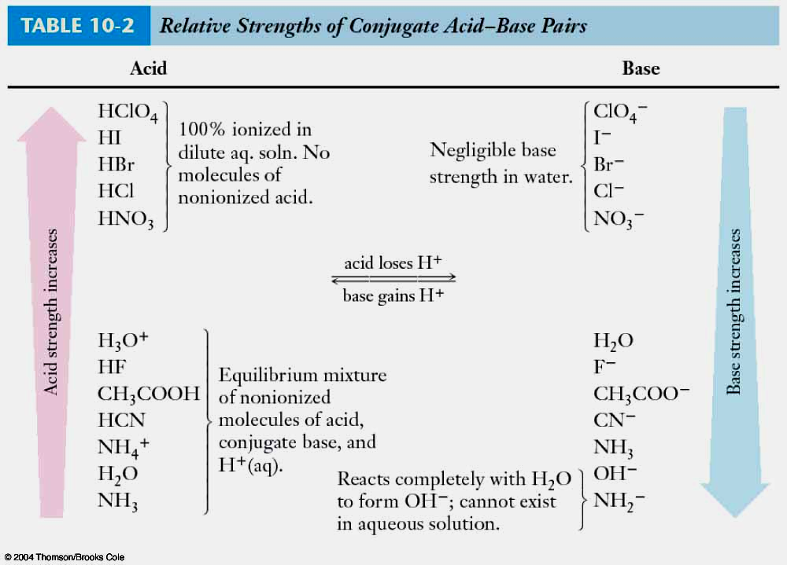
Strengths of Acids
It is possible to do this for essentially every acid and base (and their partners).

Slide 37
Strengths of Acids
The strongest acid that can exist in water is H₃O⁺.
HCl + H₂O → H₃O⁺ + Cl⁻
  HCl is strong enough that it forces water to accept H⁺.
The strongest base that can exist in water is OH⁻.
NH₂⁻ + H₂O → NH₃ + OH⁻
  NH₂⁻ is strong enough to remove H⁺ from water.
The reason that stronger acids and bases cannot exist in water is that water is amphiprotic.

Slide 38
Strengths of Acids
Ternary acids are hydroxides of nonmetals that produce H₃O⁺ in water.
  Consist of H, O, and a nonmetal.
HClO₄ H₃PO₄

Slide 39
Strengths of Acids
HClO₄ H₃PO₄

Slide 40
Strengths of Acids
It is a very common mistake for students to not realize that the H’s are attached to O atoms in ternary acids.
  Just because chemists write them as HClO₄.

Slide 41
Strengths of Acids
Remember that for binary acids, acid strength increased with decreasing H-X bond strength.
Ternary acids have the same periodic trend.
Strong ternary acids have weaker H-O bonds than weak ternary acids.
For example, compare acid strengths:
  HNO₂<HNO₃ H₂SO₃< H₂SO₄
This implies that the H-O bond strength is:
You do it!
HNO₂ > HNO₃ H₂SO₃ > H₂SO₄

Slide 42
Strengths of Acids
Ternary acid strength usually increases with:
an increasing number of O atoms on the central atom and
an increasing oxidation state of central atom.
Effectively, these are the same phenomenon.
  Every additional O atom increases the oxidation state of the central atom by 2.

Slide 43
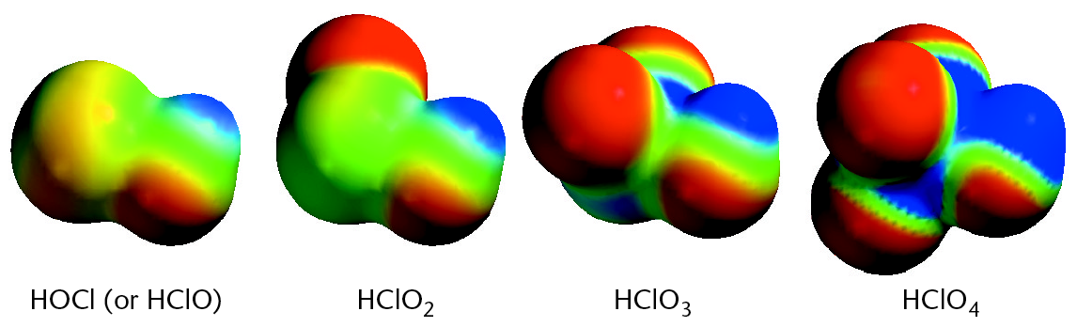
Strengths of Acids
For ternary acids having the same central atom:
  the highest oxidation state of the central atom is usually strongest acid.
For example, look at the strength of the Cl ternary acids.
  HClO < HClO₂ < HClO₃ < HClO₄
  weakest strongest
Cl oxidation states
  +2 +4 +6 +8

Slide 44
Acid-Base Reactions in
Aqueous Solutions
There are four acid-base reaction combinations that are possible:
  Strong acids – strong bases
  Weak acids – strong bases
  Strong acids – weak bases
  Weak acids – weak bases
Let us look at one example of each acid-base reaction.

Slide 45
Acid-Base Reactions in
Aqueous Solutions
Strong acids - strong bases
  forming soluble salts
This is one example of several possibilities
  hydrobromic acid + calcium hydroxide
The molecular equation is:
  You do it!
2 HBr_{(aq)} + Ca(OH)_{2(aq)} → CaBr_{2(aq)} + 2 H₂O_{()}

Slide 46
Acid-Base Reactions in
Aqueous Solutions
The total ionic equation is:
You do it!
2H⁺_{(aq)} + 2Br⁻_{(aq)} + Ca²⁺_{(aq)} + 2OH⁻_{(aq)} → Ca²⁺_{(aq)} + 2Br⁻_{(aq)} + 2H₂O_{()}
The net ionic equation is:
You do it!
2H⁺ _{(aq)} + 2OH⁻ _{(aq)} → 2H₂O_{()}
or
H⁺ _{(aq)} + OH⁻₍ _{aq)} → H₂O_{()}
  This net ionic equation is the same for all strong acid - strong base reactions that form soluble salts

Slide 47
Acid-Base Reactions in
Aqueous Solutions
Strong acids-strong bases
  forming insoluble salts
There is only one reaction of this type:
  sulfuric acid + barium hydroxide
The molecular equation is:
You do it!
H₂SO_{4(aq)} + Ba(OH)_{2(aq)} → BaSO_{4(s)}+ 2H₂O_{()}

Slide 48
Acid-Base Reactions in
Aqueous Solutions
The total ionic equation is:
You do it!
2H⁺_{(aq)} + SO₄²⁻_{(aq)} + Ba²⁺_{(aq)} + 2OH⁻_{(aq)} → BaSO_{4(s)} + 2H₂O_{()}
The net ionic equation is:
You do it!
2H⁺_{(aq)} + SO₄²⁻_{(aq)} + Ba²⁺_{(aq)} + 2OH⁻_{(aq)} → BaSO_{4(s)} + 2H₂O_{()}

Slide 49
Acid-Base Reactions in
Aqueous Solutions
Weak acids - strong bases
  forming soluble salts
This is one example of many possibilities:
  nitrous acid + sodium hydroxide
The molecular equation is:
You do it!
HNO_{2(aq)} + NaOH_{(aq)} → NaNO_{2(aq)} + H₂O_{()}

Slide 50
Acid-Base Reactions in
Aqueous Solutions
The total ionic equation is:
  Reminder – there are 3 types of substances that are written as ionized in total and net ionic equations.
    Strong acids
    Strong bases
    Strongly water soluble salts
You do it!
HNO_{2(aq)} + Na⁺_{(aq)} + OH⁻_{(aq)}→ Na⁺_{(aq)} + NO₂⁻_{(aq)} + H₂O_{()}
The net ionic equation is:
You do it!
HNO_{2(aq)} + OH⁻_{(aq)} → NO₂⁻_{(aq)} + H₂O_{()}

Slide 51
Acid-Base Reactions in
Aqueous Solutions
Strong acids - weak bases
  forming soluble salts
This is one example of many.
  nitric acid + ammonia
The molecular equation is:
You do it!
HNO_{3(aq)} + NH_{3(aq)} → NH₄NO_{3(aq)}

Slide 52
Acid-Base Reactions in
Aqueous Solutions
The total ionic equation is:
You do it!
H⁺_{(aq)} + NO₃⁻_{(aq)} + NH_{3(aq)}→ NH₄⁺_{(aq)} + NO₃⁻_{(aq)}
The net equation is:
You do it!
H⁺_{(aq)} + NH_{3(aq)} → NH₄⁺_{(aq)}

Slide 53
Acid-Base Reactions in
Aqueous Solutions
Weak acids - weak bases
  forming soluble salts
This is one example of many possibilities.
  acetic acid + ammonia
The molecular equation is:
You do it!
CH₃COOH_{(aq)} + NH_{3(aq)} → NH₄CH₃COO_{(aq)}

Slide 54
Acid-Base Reactions in
Aqueous Solutions
The total ionic equation is:
You do it!
CH₃COOH_{(aq)} + NH_{3(aq)} → NH₄⁺_{(aq)} + CH₃COO⁻_{(aq)}
The net ionic equation is:
You do it!
CH₃COOH_{(aq)} + NH_{3(aq)} → NH₄⁺_{(aq)} + CH₃COO⁻_{(aq)}

Slide 55
Acidic Salts and Basic Salts
Acidic salts are formed by the reaction of polyprotic acids with less than the stoichiometric amount of base.
For example, if sulfuric acid and sodium hydroxide are reacted in a 1:1 ratio.
H₂SO_{4(aq)} + NaOH_{(aq)} → NaHSO_{4(aq)} + H₂O_{()}
  The acidic salt sodium hydrogen sulfate is formed.
If sulfuric acid and sodium hydroxide are reacted in a 1:2 ratio.
H₂SO_{4(aq)} + 2NaOH_{(aq)} → Na₂SO_{4(aq)} + 2H₂O_{()}
  The normal salt sodium sulfate is formed.

Slide 56
Acidic Salts and Basic Salts
Similarly, basic salts are formed by the reaction of polyhydroxy bases with less than the stoichiometric amount of acid.
If barium hydroxide and hydrochloric acid are reacted in a 1:1 ratio.
You do it!
Ba(OH)_{2(aq)} + HCl_{(aq)} → Ba(OH)Cl_{(aq)} + H₂O_{()}
  The basic salt is formed.
If the reaction is in a 1:2 ratio.
Ba(OH)_{2(aq)} + 2HCl_{(aq)} → BaCl_{2(aq)} + 2H₂O_{()}
  The normal salt is formed.

Slide 57
Acidic Salts and Basic Salts
Both acidic and basic salts can neutralize acids and bases.
  However the resulting solutions are either acidic or basic because they form conjugate acids or bases.
    Another example of BrØnsted-Lowry theory.
    This is an important concept in understanding buffers.
An acidic salt neutralization example is:
NaHSO_{4(aq)} + NaOH_{(aq)} → Na₂SO_{4 (aq)} + H₂O_{()}
A basic salt neutralization example is:
Ba(OH)Cl_{(aq)} + HCl_{(aq)} → BaCl_{2(aq)} + H₂O_{()}

Slide 58
The Lewis Theory
Developed in 1923 by G.N. Lewis.
  This is the most general of the present day acid-base theories.
  Emphasis on what the electrons are doing as opposed to what the protons are doing.
Acids are defined as electron pair acceptors.
Bases are defined as electron pair donors.
Neutralization reactions are accompanied by coordinate covalent bond formation.

Slide 59
The Lewis Theory
One Lewis acid-base example is the ionization of ammonia.

Slide 60
The Lewis Theory
Look at this reaction in more detail paying attention to the electrons.

Slide 61
The Lewis Theory
A second example is the ionization of HBr.
HBr + H₂O → H₃O⁺ + Br⁻
  acid base

Slide 62
The Lewis Theory
Again, a more detailed examination keeping our focus on the electrons.

Slide 63
The Lewis Theory
A third Lewis example is the autoionization of water.
  You do it

Slide 64
The Lewis Theory
The reaction of sodium fluoride and boron trifluoride provides an example of a reaction that is only a Lewis acid-base reaction.
  It does not involve H⁺ at all, thus it cannot be an Arrhenius nor a Brønsted-Lowry acid-base reaction.
NaF + BF₃ → Na⁺ + BF₄⁻
You must draw the detailed picture of this reaction to determine which is the acid and which is the base.

Slide 65
The Lewis Theory

Slide 66
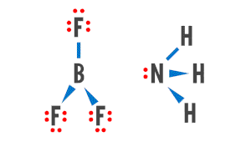

The Lewis Theory
BF₃ is a strong Lewis acid. Another example of it reacting with NH₃ is shown in this movie.

Slide 67
The Lewis Theory
Look at the reaction of ammonia and hydrobromic acid.
NH₃ + HBr → NH₄⁺+ Br⁻
Is this reaction an example of:
  Arrhenius acid-base reaction,
  Brønsted-Lowry acid base reaction,
  Lewis acid-base reaction,
  or a combination of these?
You do it!
It is a Lewis and Brønsted-Lowry acid base reaction but not Arrhenius.

Slide 68
The Preparation of Acids
The binary acids are prepared by reacting the nonmetallic element with H₂.
H_{2(g)} + Cl_{2(g)} → 2HCl_{(g)}
  This reaction is performed in the presence of UV light.
Volatile acids, ones with low boiling points, are prepared by reacting salts with a nonvolatile acid like sulfuric or phosphoric.
NaCl_{(s)} + H₂SO_{4(conc.)} → NaHSO_{4(s)} + HCl_{(g)}
NaF_{(s)} + H₂SO_{4(conc.)} → NaHSO_{4(s)} + HF_{(g)}

Slide 69
The Preparation of Acids
We must use phosphoric acid to make HBr and HI.
NaBr_{(s)} + H₃PO_{4(conc.)} → NaH₂PO_{4(s)} + HBr_{(g)}
NaI_{(s)} + H₃PO_{4(conc.)} → NaH₂PO_{4(s)} + HI_{(g)}

Slide 70
The Preparation of Acids
Ternary acids are made by reacting nonmetal oxides (acid anhydrides) with water.
SO_{2(g)} + H₂O_{()} → H₂SO_{3(aq)}
N₂O_{5(g)} + H₂O_{()} → 2 HNO_{3(aq)}
Some nonmetal halides and oxyhalides react with water to give both a binary and a ternary acid.
PCl_{5(s)} + 4 H₂O_{()} → H₃PO_{4(aq)} + 5 HCl_{(aq)}
POCl_{3()} + 3 H₂O_{()} → H₃PO_{4(aq)} + 3 HCl_{(aq)}

Slide 71
Synthesis Question
One method of increasing the solubility and the absorption of a medication is to convert weakly acidic drugs into sodium salts before making the pills that will be ingested. How does this preparation method enhance the drug’s solubility in the stomach?

Slide 72
Synthesis Question
The sodium salt of a weakly acidic compound is a strong conjugate base. In the presence of stomach fluids, ~ 1.0 M HCl, the conjugate base readily reacts with the HCl generating the active and soluble form of the medication.

Slide 73
Group Question
Medicines that are weakly basic are not absorbed well into the bloodstream. One method to increase their absorption is to take an antacid at the same time that the medicine is administered. How does this method increase the absorption?

Slide 74
End of Chapter 10
Many medicines are deliberately made as conjugate acids or bases so that they become active ingredients after passage through the stomach.

